Slide 1
Học máy trong phân tích kinh doanh
Bài Học
Customize Development Sentiment model application
Giảng viên:
TS. Trần Duy Thanh
Email: thanhtd@uel.edu.vn
Blog: https://tranduythanh.com

Slide 2
Mục tiêu bài học
Build and customize Sentiment model for end to end app
Deep understand the steps in Machine Learning:
Preparing Dataset
Split Dataset to train and test set
Choose algorithm to train the model
Evaluation the model
Save the model
Use the model
Use BackgroundWorker to update realtime processing GUI

Slide 3
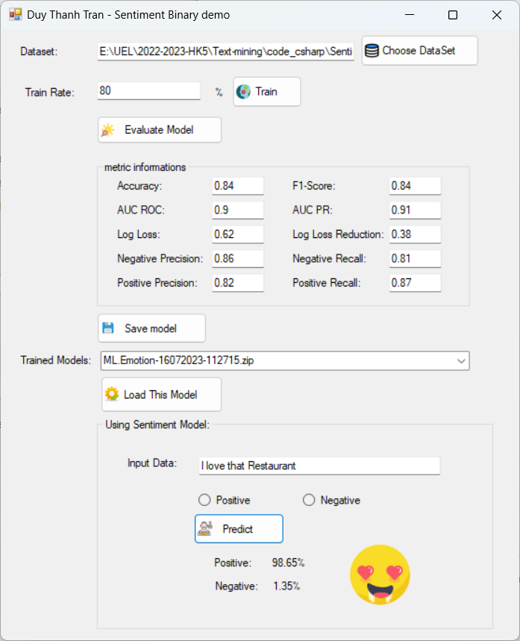
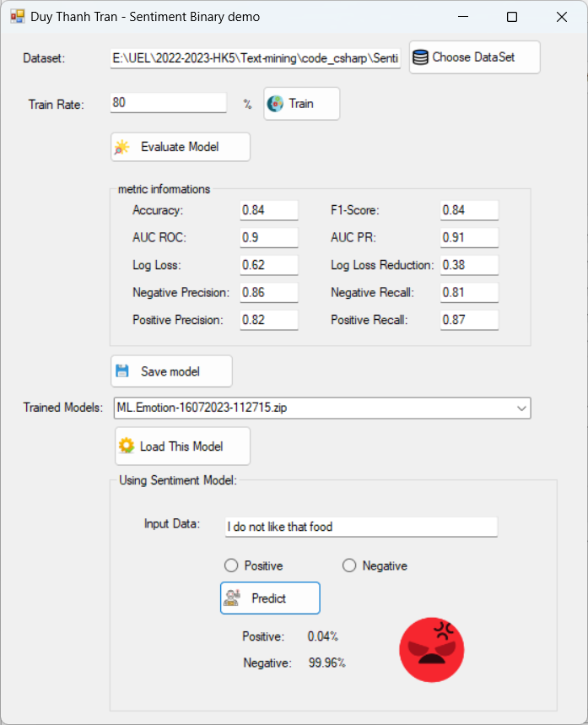
Customize Sentiment Model

Slide 4
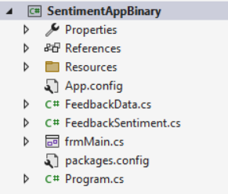
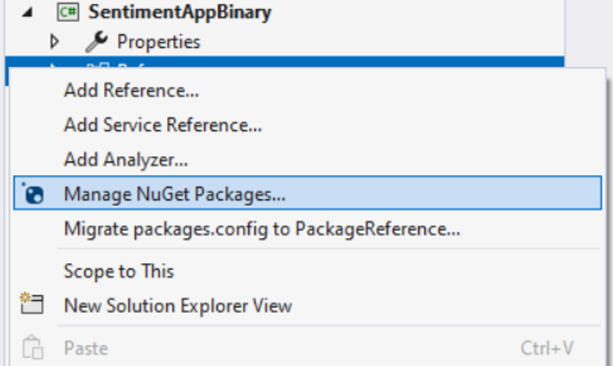
Customize Sentiment Model
Create SentimentAppBinary project (.net framework)
Right mouse click and choose Manage Nuget Packages

Slide 5
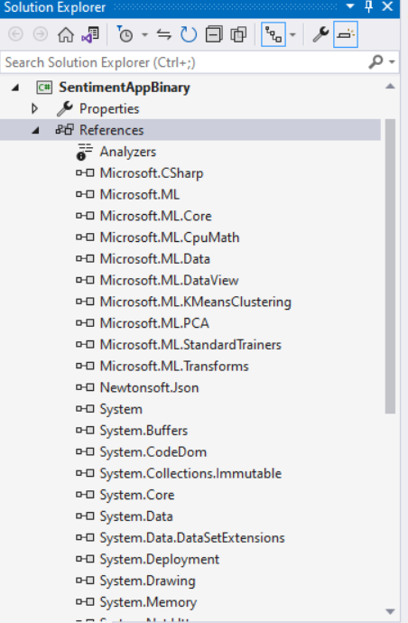
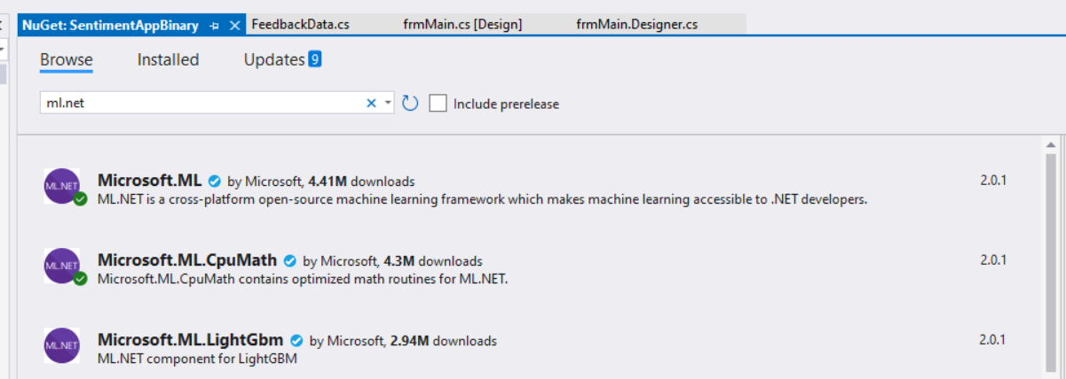
Customize Sentiment Model
Install Microsoft.ML

Slide 6
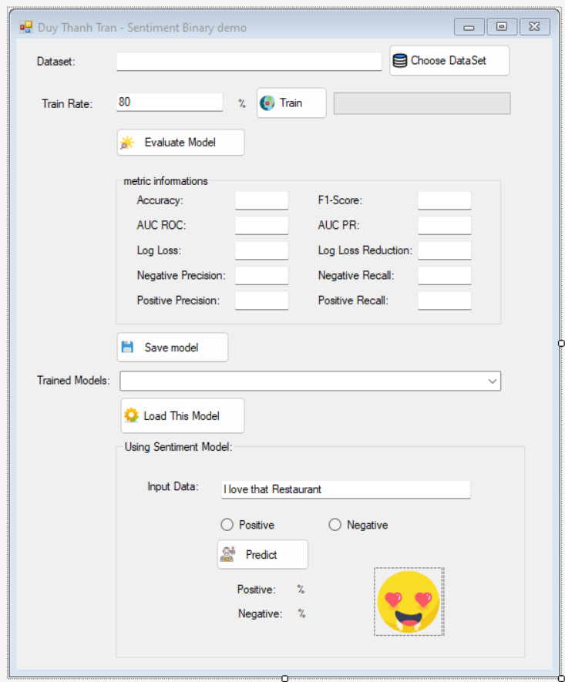
Customize Sentiment Model
txtDataset
btnPicDataset
txtTrainRate
progressBarTrain
btnTrain
btnEvaluate
txtF1Score
txtAUCPR
txtLogLossReduction
txtNegativeRecall
txtPositiveRecall
txtAccuracy
txtAUCROC
txtLogLoss
txtNegativePrecision
txtPositivePrecision
btnSaveModel
cboModel
btnLoadModel
txtInputData
radPositive
radNegative
btnPredict
picPositive
lblPositiveProbability
picNegative
lblNegativeProbability

Slide 7
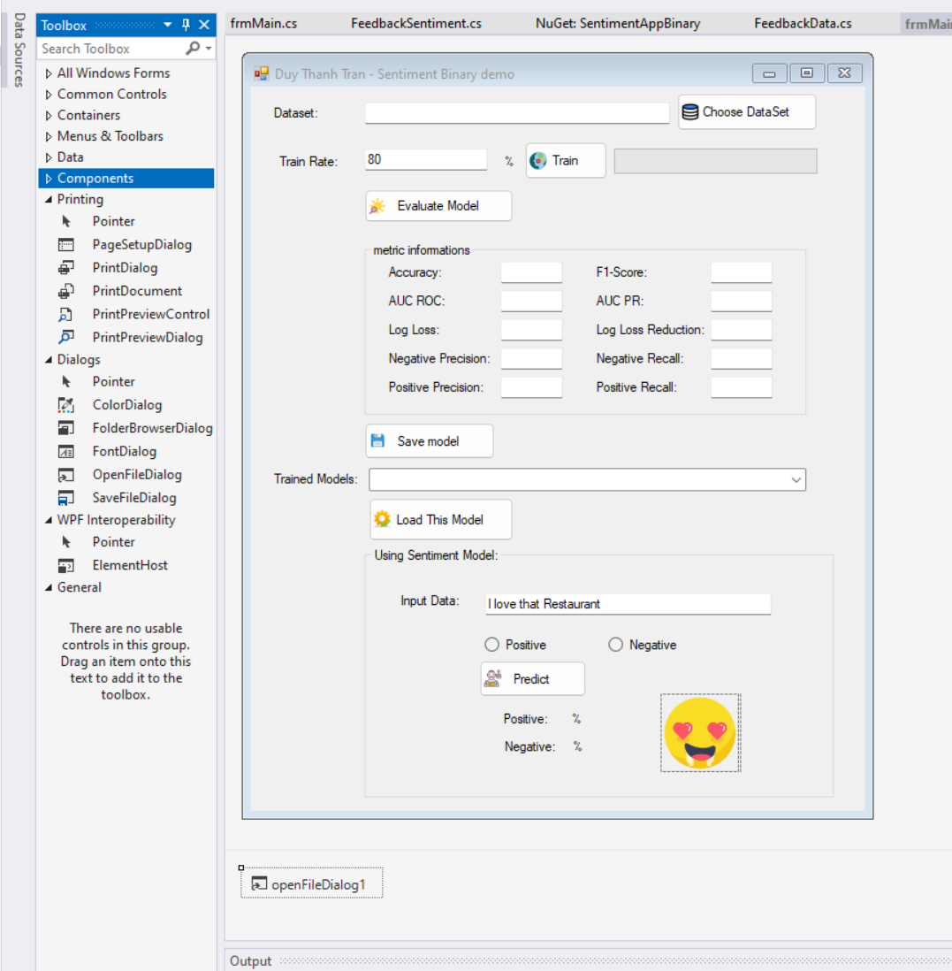
Customize Sentiment Model

Slide 8
Customize Sentiment Model
namespace SentimentAppBinary
{
public class FeedbackData
{
[LoadColumn(0)]
public string Data;
[LoadColumn(1), ColumnName("Label")]
public bool Lable;
}
}

Slide 9
Customize Sentiment Model
namespace SentimentAppBinary
{
public class FeedbackSentiment : FeedbackData
{
[ColumnName("PredictedLabel")]
public bool PredictedLabel { get; set; }
[ColumnName("Probability")]
public float Probability { get; set; }
}
}

Slide 10
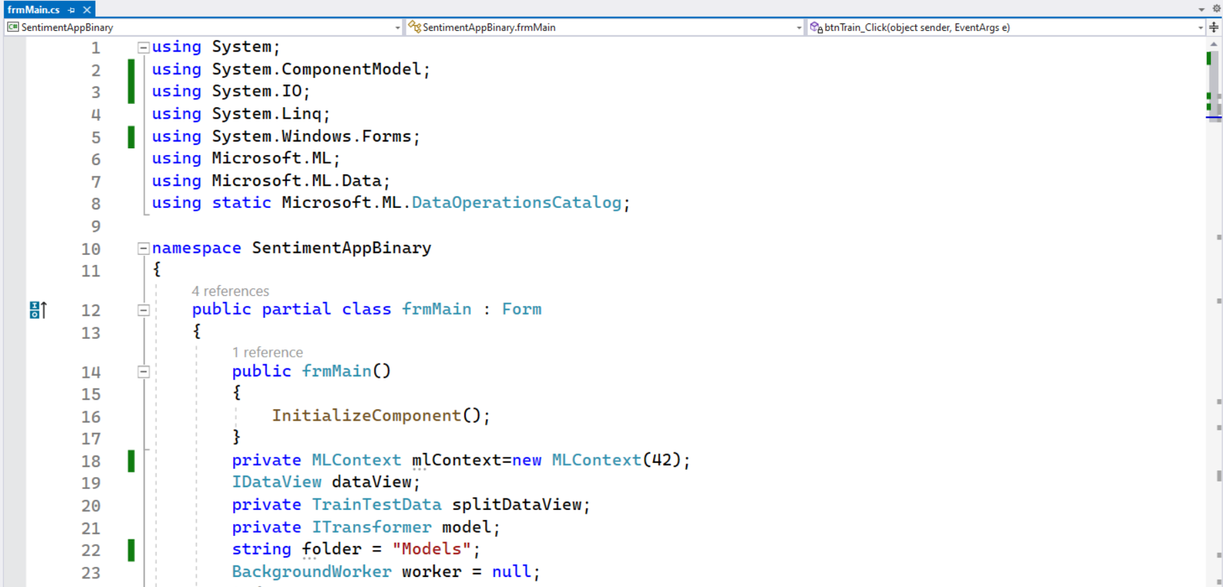
Customize Sentiment Model

Slide 11
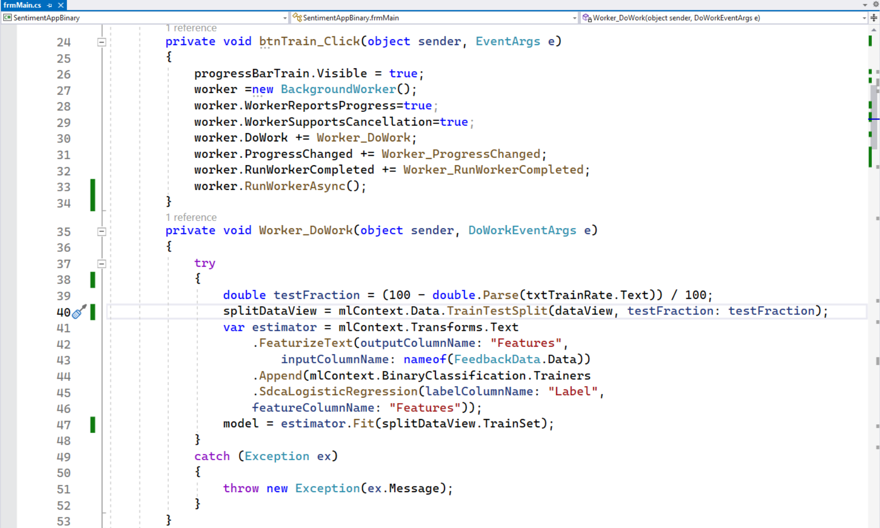
Customize Sentiment Model

Slide 12
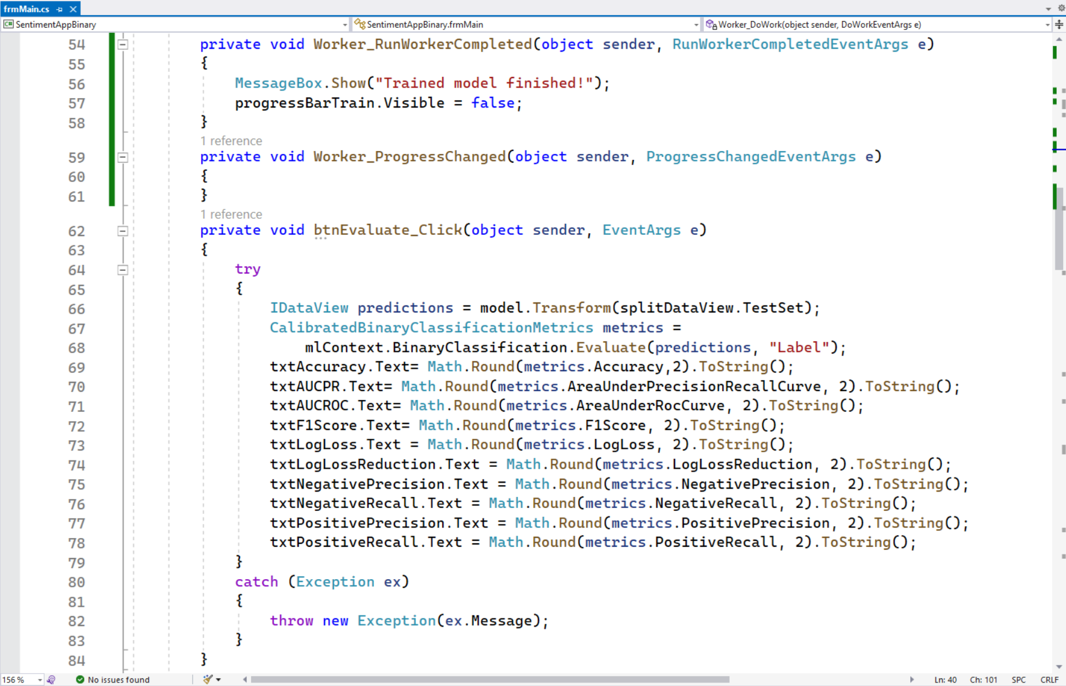
Customize Sentiment Model

Slide 13
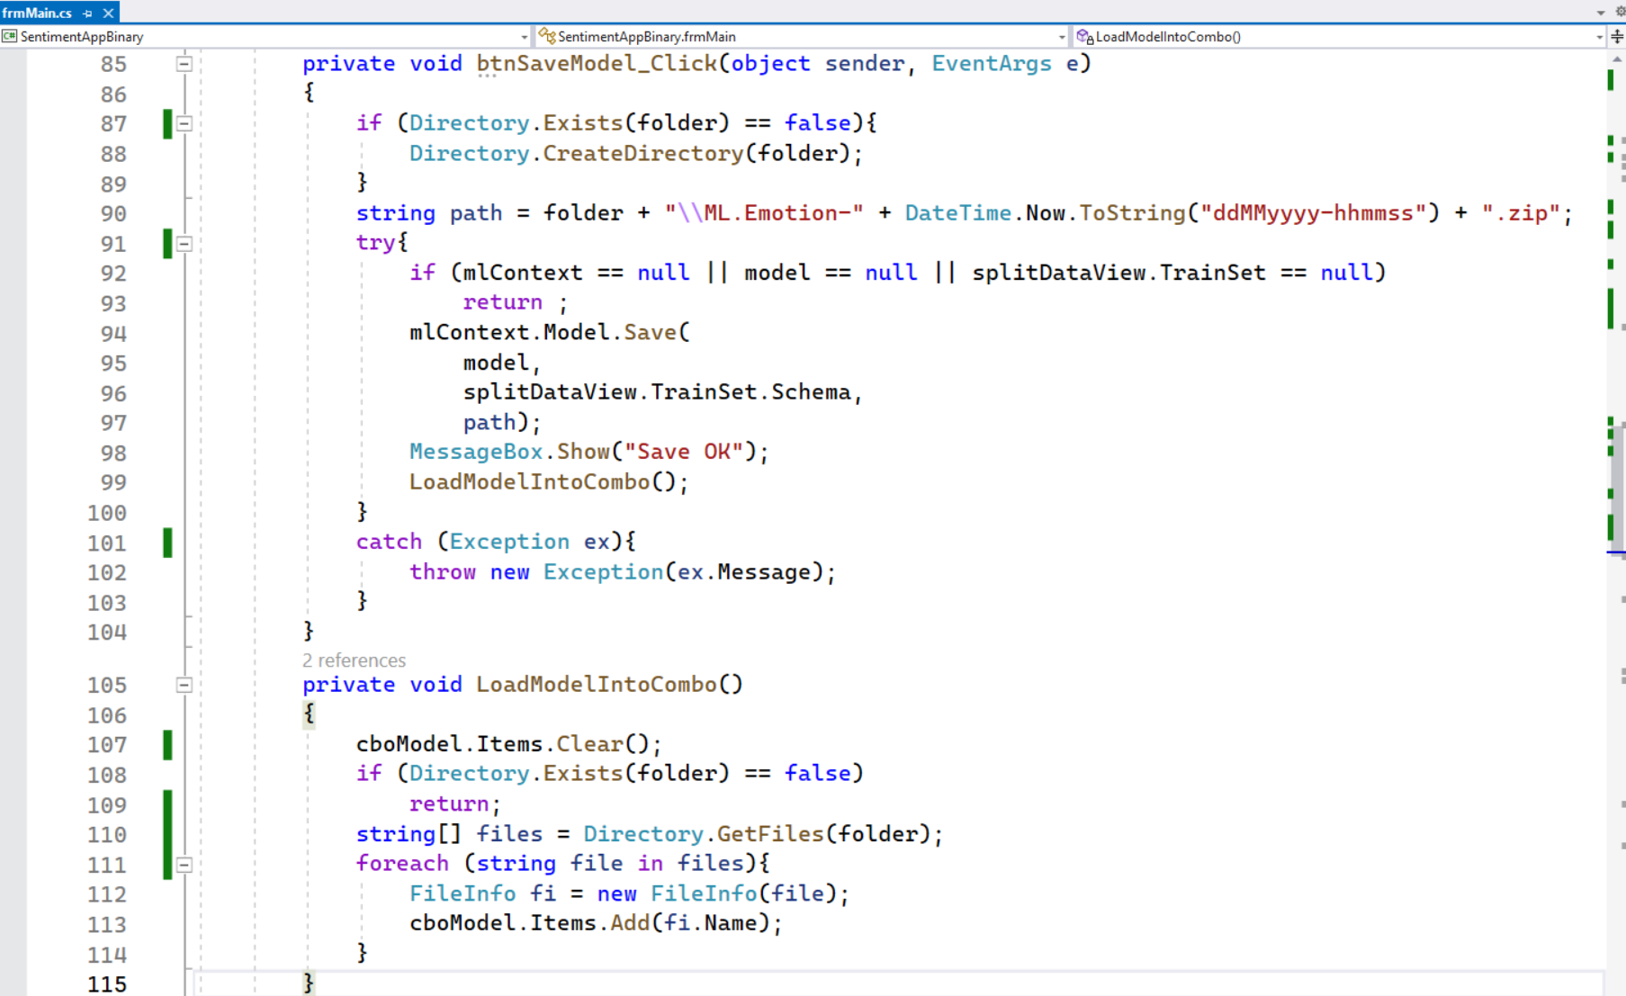
Customize Sentiment Model

Slide 14
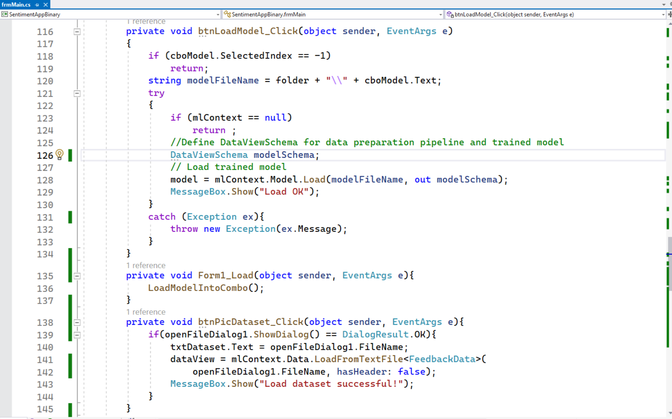
Customize Sentiment Model

Slide 15
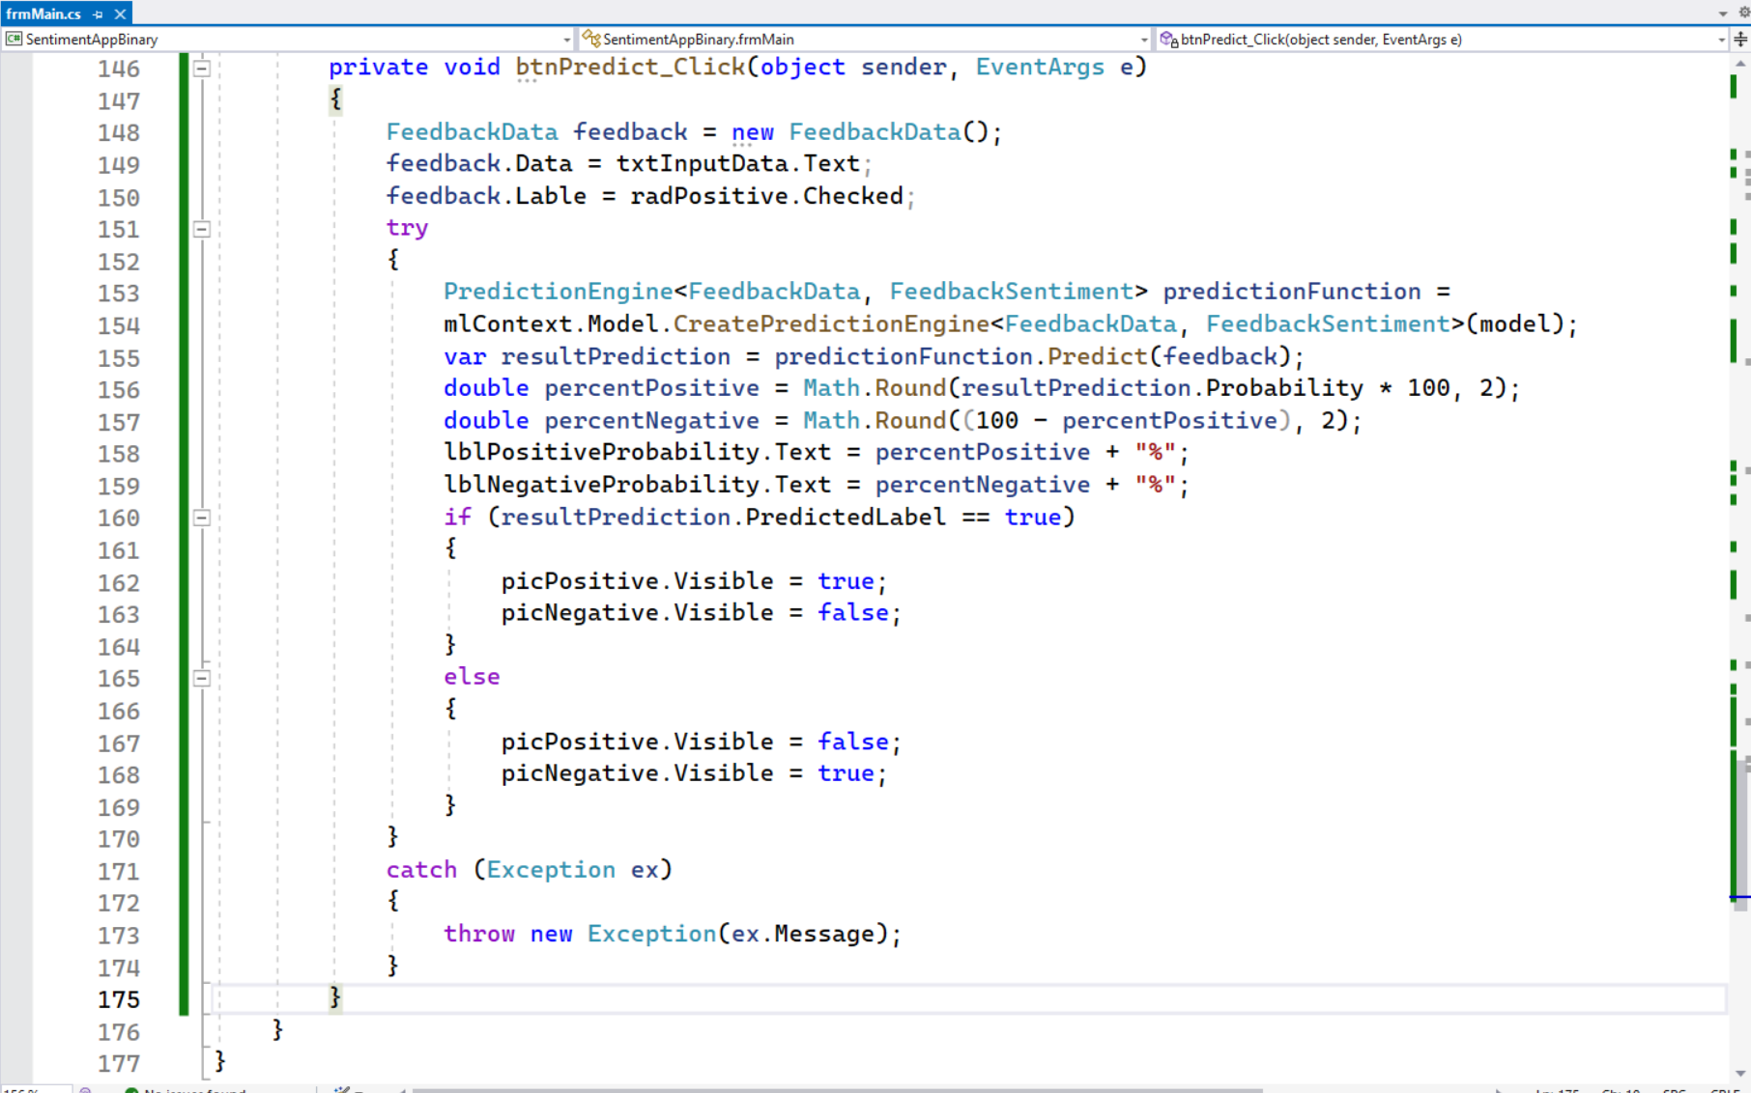
Customize Sentiment Model

Slide 16
Bài học tiếp theo
7.5. Tích hợp mô hình máy học vào dự án có sẵn

Slide 17
THANK YOU!

